Slide 1
PROJECT 35
Design and Implementation of a
Database Management System for
Internship Application and
Progress Monitoring System
REVIEW 1 | Conceptual Design & Initial Schema

Slide 2
1. Problem Identification
Why a centralized internship database is needed
01
Scattered records
02
Tracking difficulty
Applications, approvals and progress data are stored across files, emails and spreadsheets.
Students and faculty cannot easily see application status or current internship progress.
03
Manual coordination
04
Verification gaps
Approvals, mentor assignment and supervisor communication require repeated manual work.
Weekly logs, evaluations and completion records are difficult to verify consistently.
CORE PROBLEM
Lack of one reliable system to manage the complete internship lifecycle and produce timely progress reports.
PROJECT 35 • REVIEW 1
02

Slide 3
2. Scope & Objectives
From opportunity publication to internship completion
SCOPE
OBJECTIVES
• Student and organization management
• Internship opportunity management
• Application and approval tracking
• Faculty mentor and company supervisor assignment
• Weekly progress monitoring
• Evaluation, feedback and certificate management
• Centralize internship information
• Reduce manual tracking effort
• Monitor student progress systematically
• Maintain accurate and consistent records
• Support meaningful reports and decisions
• Enforce data integrity through DBMS constraints
Opportunity
Application
Approval
Assignment
Progress
Evaluation
Completion
→
→
→
→
→
→
PROJECT 35 • REVIEW 1
03

Slide 4
3. Users & Functional Requirements
Who interacts with the system and what they need to do
S
STUDENT
A
COLLEGE / ADMIN
M
FACULTY MENTOR
View opportunities • Apply • Track status • Submit weekly logs • View evaluations & certificate
Manage organizations • Publish opportunities • Process applications • Assign mentors • Reports
Monitor assigned students • Review logs • Evaluate • Provide feedback
C
COMPANY SUPERVISOR
O
ORGANIZATION
Supervise interns • Review progress • Submit evaluation
Provide opportunities • Maintain company supervisor information
PROJECT 35 • REVIEW 1
04

Slide 5
4. Internship Lifecycle
A single workflow connecting every stage
01
→
02
→
03
→
04
→
05
→
06
→
07
OPPORTUNITY
APPLICATION
APPROVAL
ASSIGNMENT
PROGRESS
EVALUATION
COMPLETION
Organization publishes
internship opening
Student applies
for opportunity
College reviews
application
Mentor + supervisor
are assigned
Weekly logs record
internship activity
Performance is
assessed
Certificate and
feedback are recorded
Business flow: approval must occur before assignment; progress logs belong to the assigned internship.
PROJECT 35 • REVIEW 1
05

Slide 6
5. Major Entities
Principal entities identified for the conceptual model
STUDENT
ORGANIZATION
OPPORTUNITY
Student profile & academic details
Internship provider
Published internship opening
APPLICATION
APPROVAL
FACULTY MENTOR
Student's application
Decision on an application
College-side mentor
COMPANY SUPERVISOR
ASSIGNMENT
WEEKLY LOG
Industry-side supervisor
Approved internship allocation
Weekly progress record
EVALUATION
CERTIFICATE
FEEDBACK
Performance assessment
Completion certificate
Post/ongoing feedback
PROJECT 35 • REVIEW 1
06

Slide 7
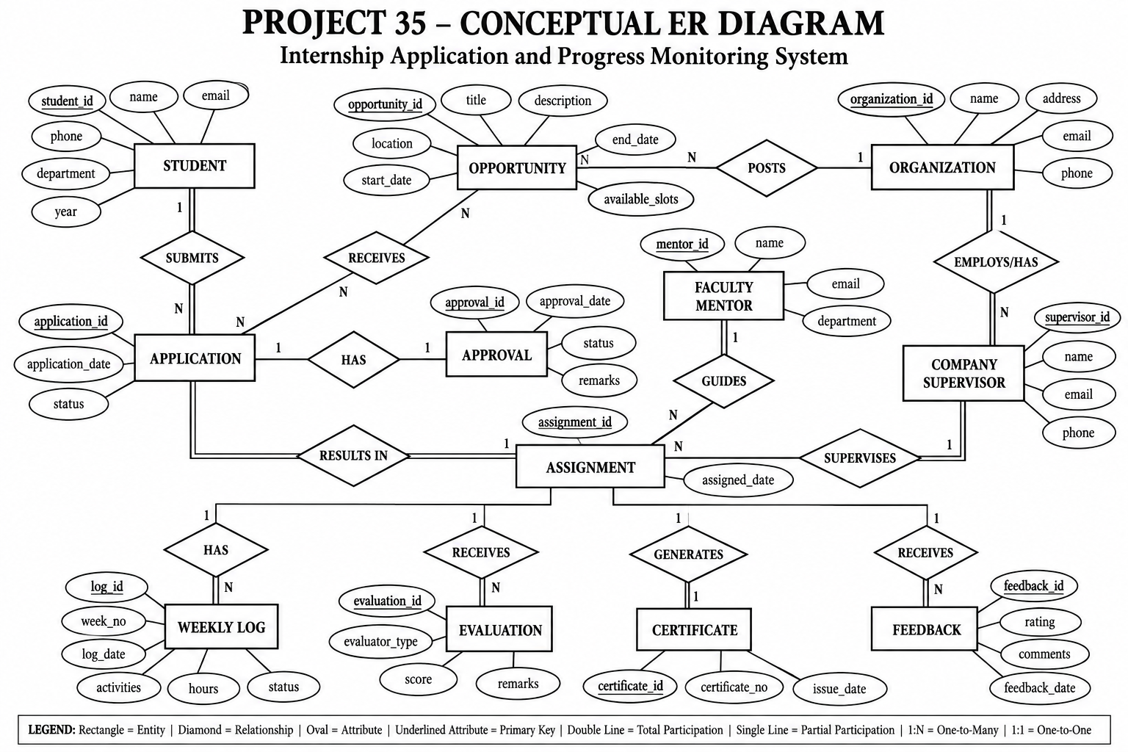


6. Conceptual ER Diagram
Core entities, relationships and cardinalities
APPLICATION
OPPORTUNITY
ORGANIZATION
STUDENT
PK application_id
FK student_id
FK opportunity_id
status
N:1
PK opportunity_id
FK organization_id
title
dates
N:1
PK organization_id
name
contact
1:N
PK student_id
name
email
1:N
APPROVAL
ASSIGNMENT
COMPANY
SUPERVISOR
FACULTY
MENTOR
PK approval_id
FK application_id
status
1:1
PK assignment_id
FK application_id
FK mentor_id
FK supervisor_id
N:1
PK supervisor_id
FK organization_id
name
N:1
PK mentor_id
name
department
1:N
1:N
1:1
1:N
WEEKLY LOG
EVALUATION
CERTIFICATE
FEEDBACK
PK log_id
FK assignment_id
week_no
log_date
PK evaluation_id
FK assignment_id
score
PK certificate_id
FK assignment_id
issue_date
PK feedback_id
FK assignment_id
rating
PK = Primary Key | FK = Foreign Key | 1:N = One-to-Many | 1:1 = One-to-One
PROJECT 35 • REVIEW 1
07

Slide 8
7. Initial Relational Schema
Proposed tables with primary and foreign keys
STUDENT
student_id PK | name | email | phone | department | year
ORGANIZATION
organization_id PK | name | address | email | phone
OPPORTUNITY
opportunity_id PK | organization_id FK | title | description | location | start_date | end_date | slots
APPLICATION
application_id PK | student_id FK | opportunity_id FK | application_date | status
APPROVAL
approval_id PK | application_id FK | approved_by FK | approval_date | status | remarks
FACULTY_MENTOR
mentor_id PK | name | email | department
COMPANY_SUPERVISOR
supervisor_id PK | organization_id FK | name | email | phone
ASSIGNMENT
assignment_id PK | application_id FK | mentor_id FK | supervisor_id FK | assigned_date
WEEKLY_LOG
log_id PK | assignment_id FK | week_no | log_date | activities | hours | status
EVALUATION
evaluation_id PK | assignment_id FK | evaluator_type | evaluator_id | score | remarks
CERTIFICATE
certificate_id PK | assignment_id FK | certificate_no | issue_date
FEEDBACK
feedback_id PK | assignment_id FK | submitted_by | rating | comments | feedback_date
PK = Primary Key • FK = Foreign Key
08
PROJECT 35 • REVIEW 1

Slide 9
REVIEW 1
Design Foundation Completed
The conceptual foundation of the Internship Application and Progress Monitoring System is defined.
✓
Problem and scope identified
✓
Objectives and users defined
✓
Functional requirements established
✓
12 principal entities identified
✓
Conceptual ER model designed
✓
Initial relational schema proposed
THANK YOU
Questions?

